Slide 1
iVotum
Team LFD, 05-07-2017

Slide 2
Table of Contents
Plan
Trainingen
Concept Architectuur

Slide 3

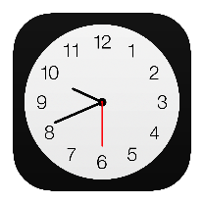



Plan - iVotum
iVotum

Slide 4



Trainingen
iVotum

Slide 5

iVotum – Blockchain Network
iVotum
iVotum
iVotum

Slide 6
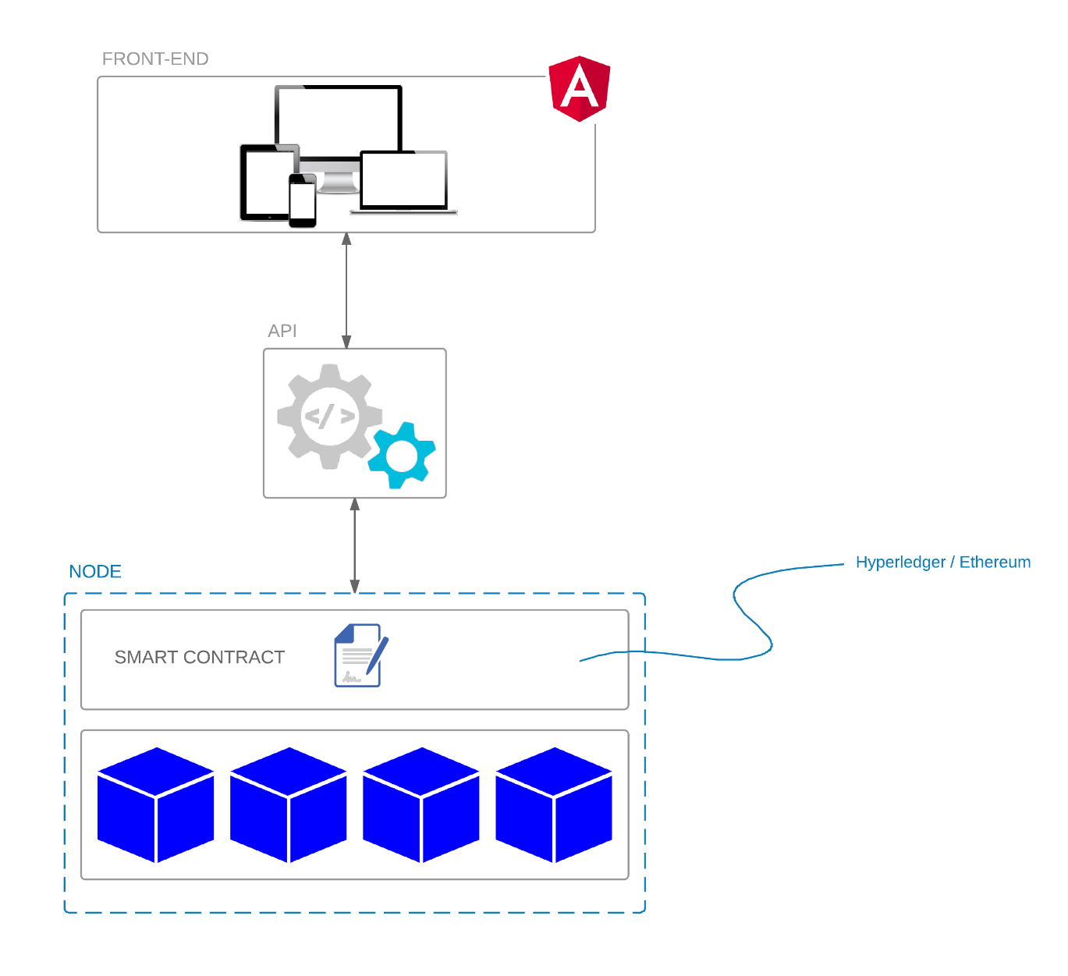
iVotum - Architectuur

